Slide 1

2025 BUSINESS ANALYSIS
FreshMart Supermarkets — Why Is Our Basket Getting Smaller?
Evidence-led diagnosis and recommended actions for retail leadership
Scope: 64,330 transactions · 42 stores · Gauteng, Western Cape & KwaZulu-Natal
Formats: Large · Medium · Express
Period: January – December 2025
Sample transactions — figures are not FreshMart's exact chain turnover. All monetary values in South African Rand (R).

Slide 2

EXECUTIVE HEADLINE
More Transactions. Smaller Baskets.
Footfall is growing, but value per trip is weakening — the core retail tension of 2025.
+6.8%
-10.0%
Transaction Volume
Avg Basket Value
H1 → H2: 31,109 to 33,221 visits
H1 R290.01 → H2 R261.10
-10.6%
-3.9%
Items per Basket
Sample Basket Total
H1 14.22 items → H2 12.72 items
R9.02m → R8.67m (sample only)
The problem is not traffic — it is value per trip. Higher footfall is masking a material deterioration in basket quality.

Slide 3
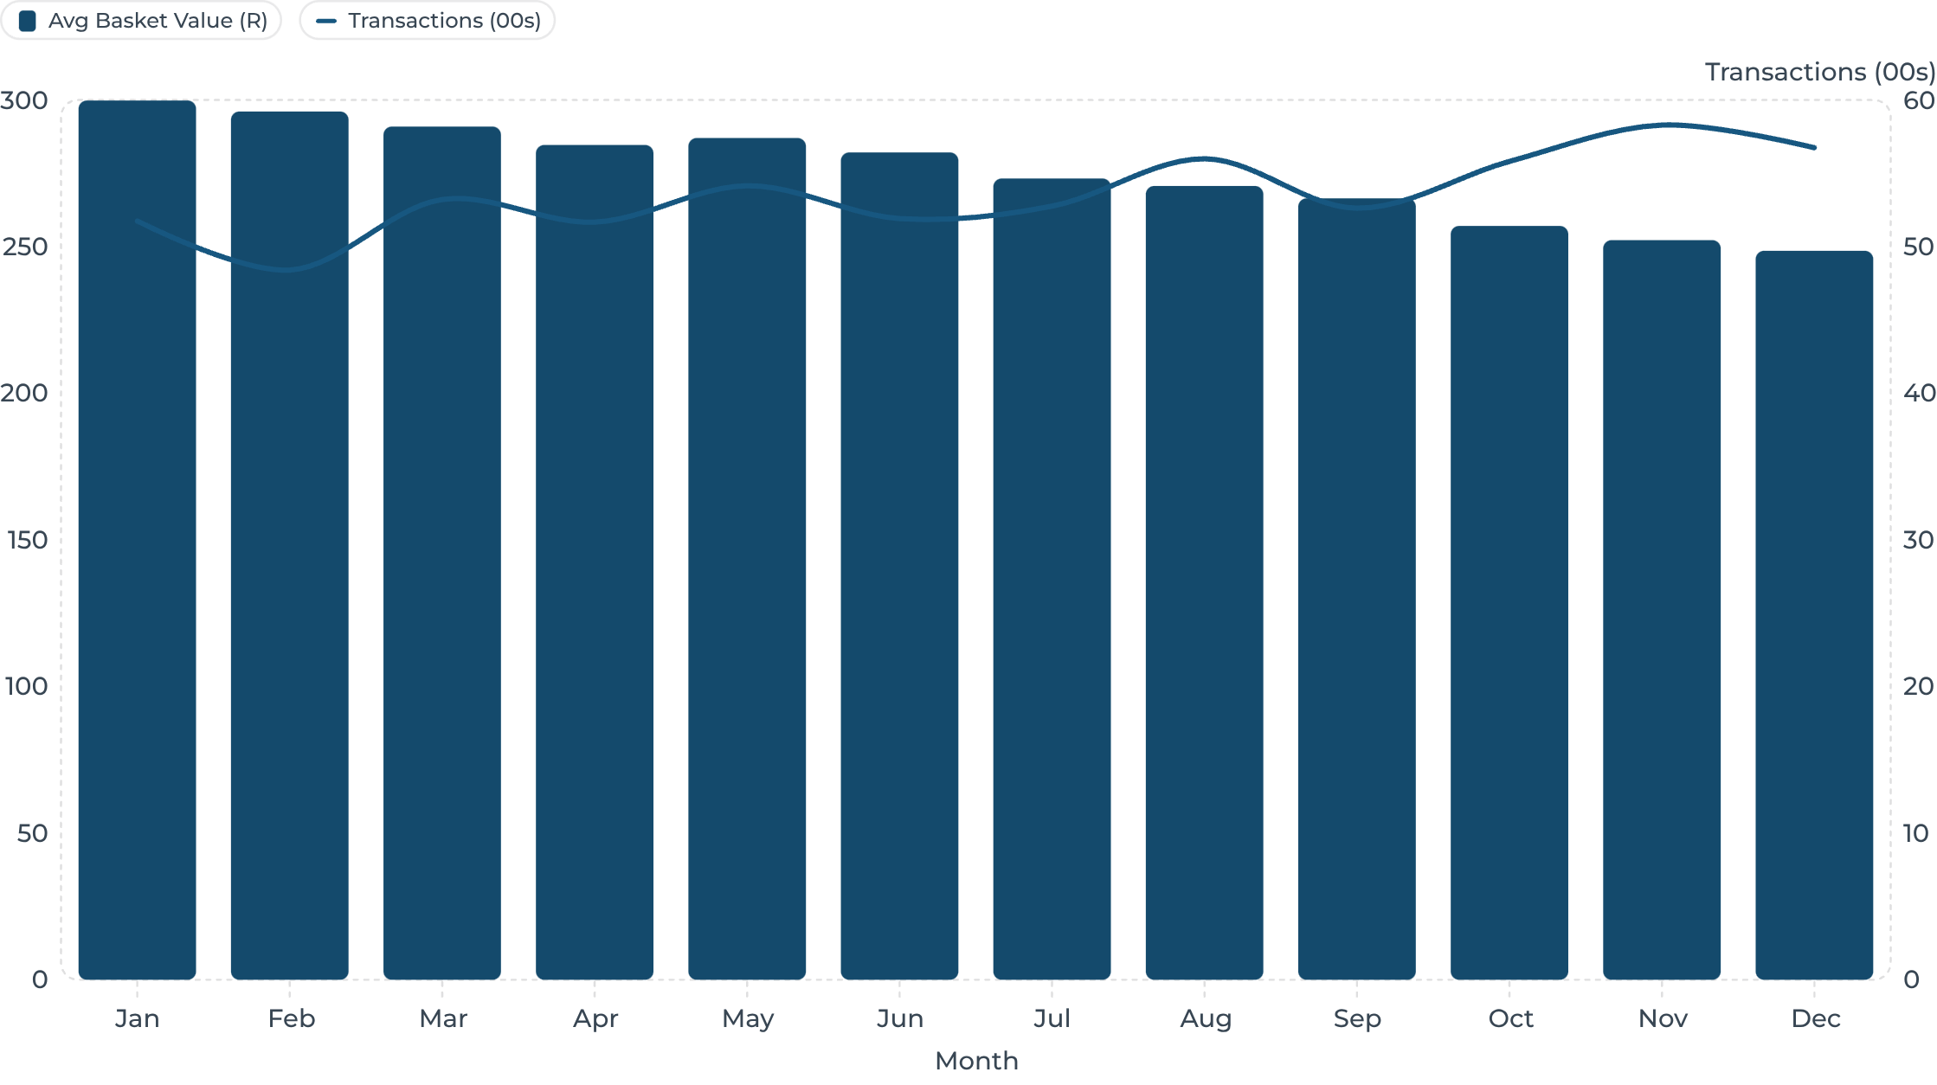
TREND ANALYSIS
Basket Value Fell Every Single Month of 2025
From R299.82 in January to R248.56 in December — an unbroken 12-month decline of 17.1% — while transaction volume remained broadly strong throughout the year.
So what: Basket value declined every month without exception — this is a structural trend, not a seasonal blip. Transaction volume (bars, scaled to 00s) held firm, confirming the traffic-vs-value divergence.

Slide 4
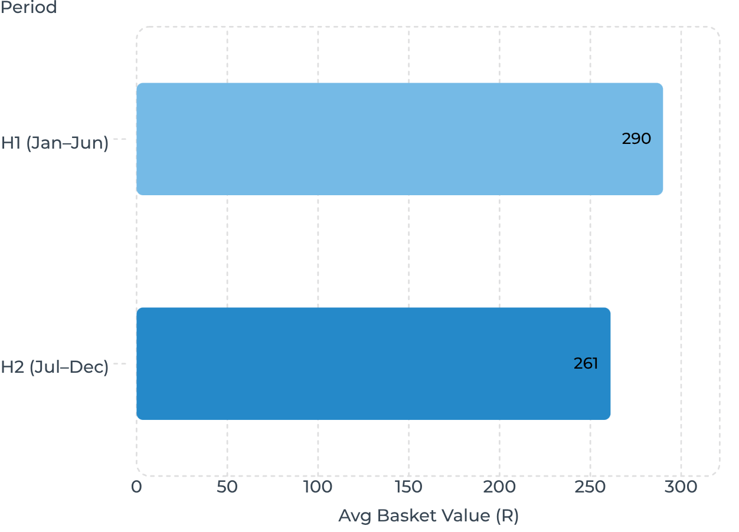
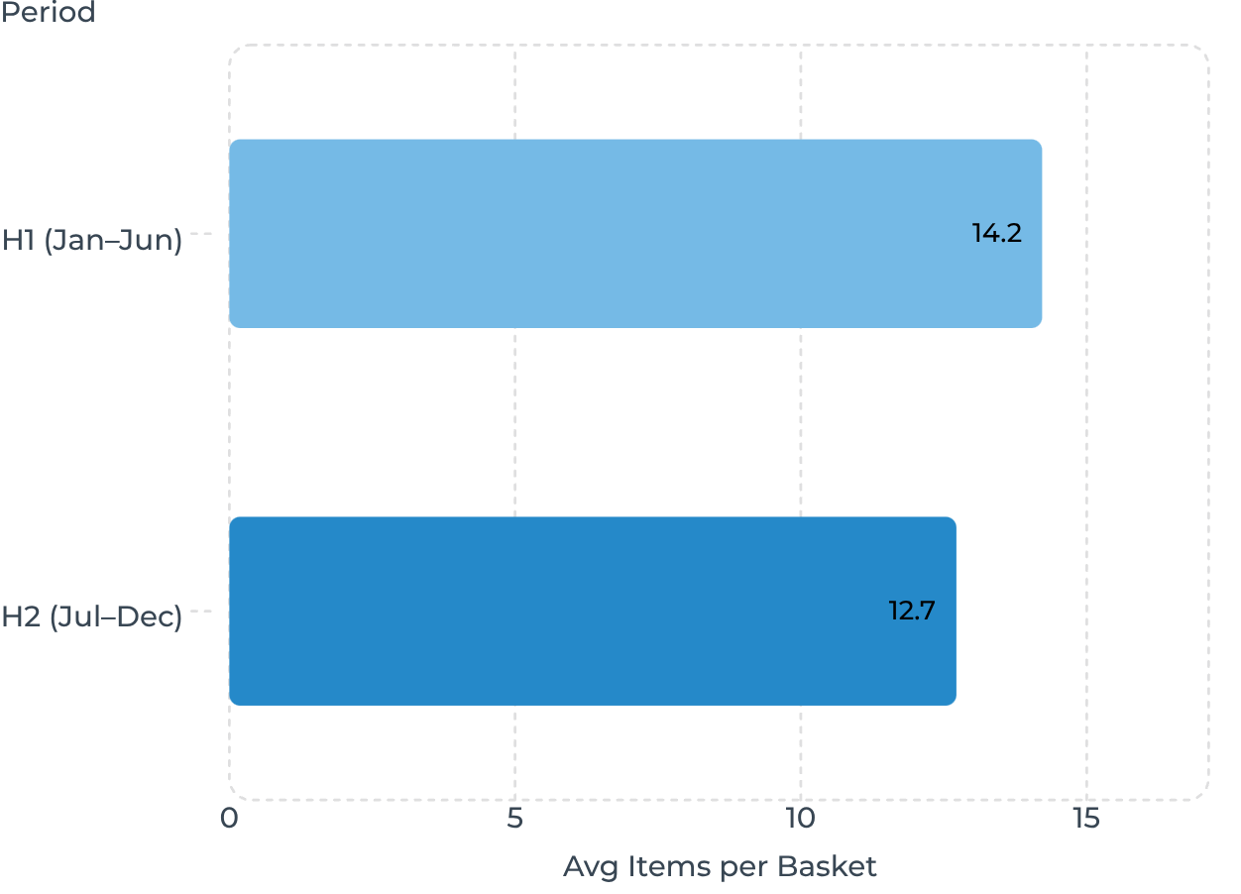
H1 VS H2 COMPARISON
H2 Baskets Are 10% Lower in Value and 10.6% Smaller in Item Count
So what: A R28.91 average basket drop in six months represents a significant and consistent value erosion.
So what: Customers are not just spending less — they are buying fewer products per trip, pointing to changed shopping intent.

Slide 5
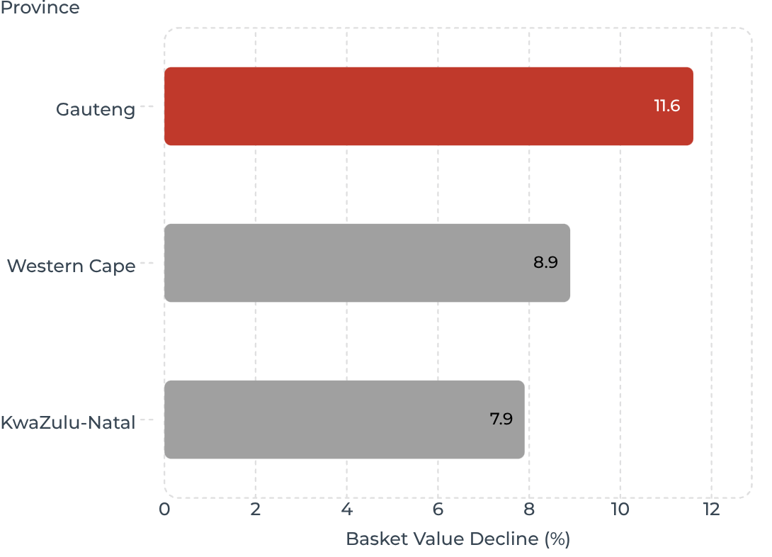
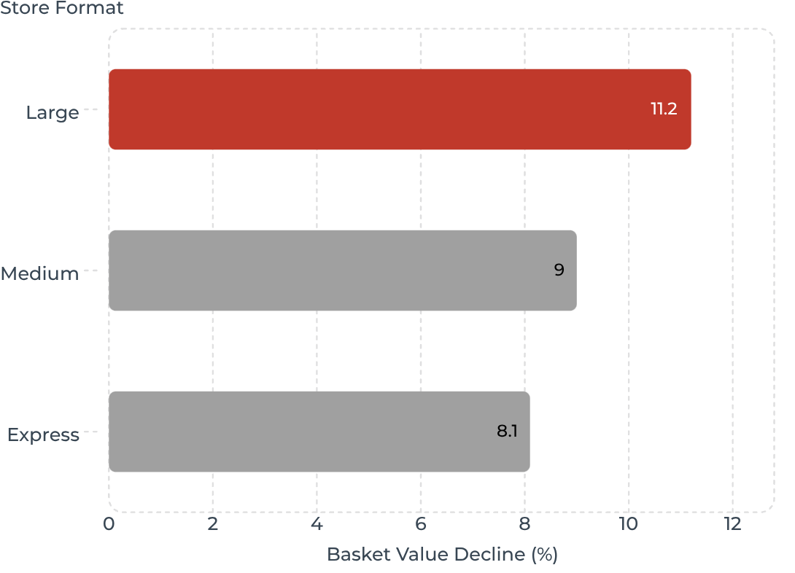
SEGMENTATION
The Decline Is National, but Gauteng and Large Stores Are the Pressure Points
H1→H2 Decline by Province
H1→H2 Decline by Store Format
So what: Gauteng shows the steepest decline at -11.6%, warranting priority intervention.
So what: Large-format stores — with the highest basket potential — are losing the most value per trip.

Slide 6
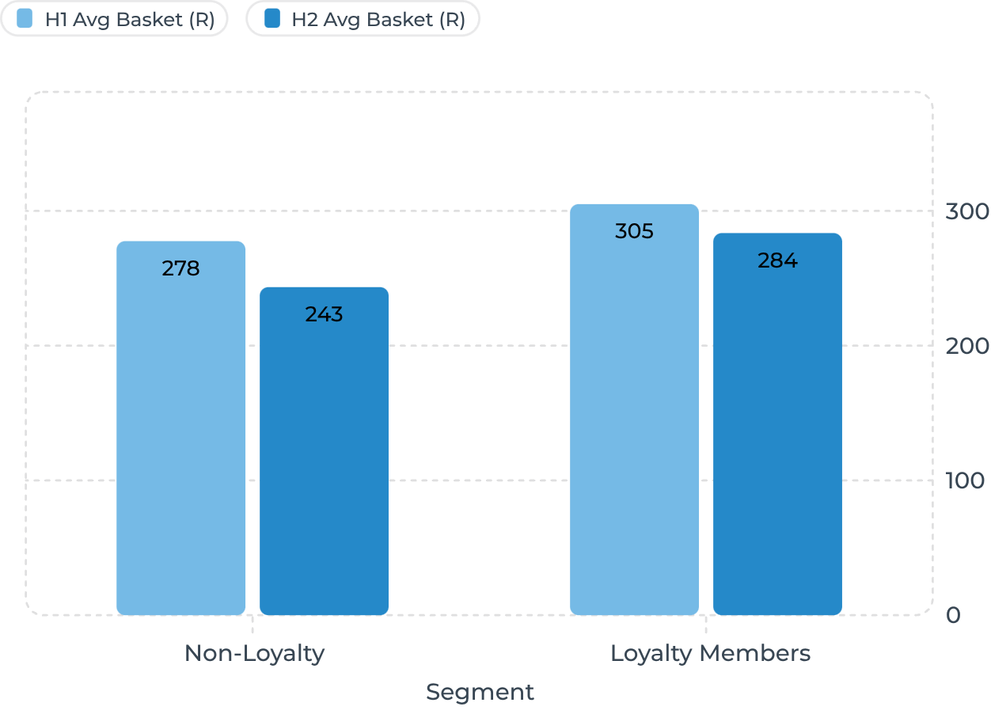
CUSTOMER BEHAVIOUR
Non-Loyalty Shoppers Show the Sharpest Basket Deterioration
Key Observations
Loyalty Buffer
Loyalty members maintained larger baskets across both halves and declined at nearly half the rate of non-members.
Non-Loyalty Risk
Non-loyalty baskets fell R34.13 in H2 — these shoppers have no programme incentive to stay. Conversion to loyalty is an immediate lever.
So what: Non-loyalty shoppers declined -12.3% vs -7.0% for loyalty members — they are both more volatile and more vulnerable to competitor alternatives.
Items Mirror Value
Non-loyalty items fell from 13.57 to 11.82; loyalty from 15.01 to 13.88 — both groups are buying fewer products.

Slide 7
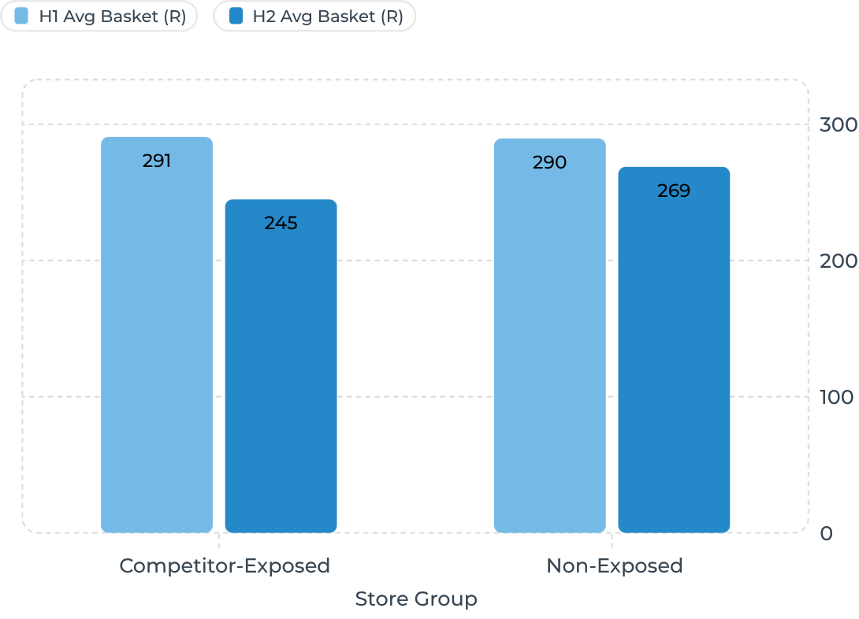
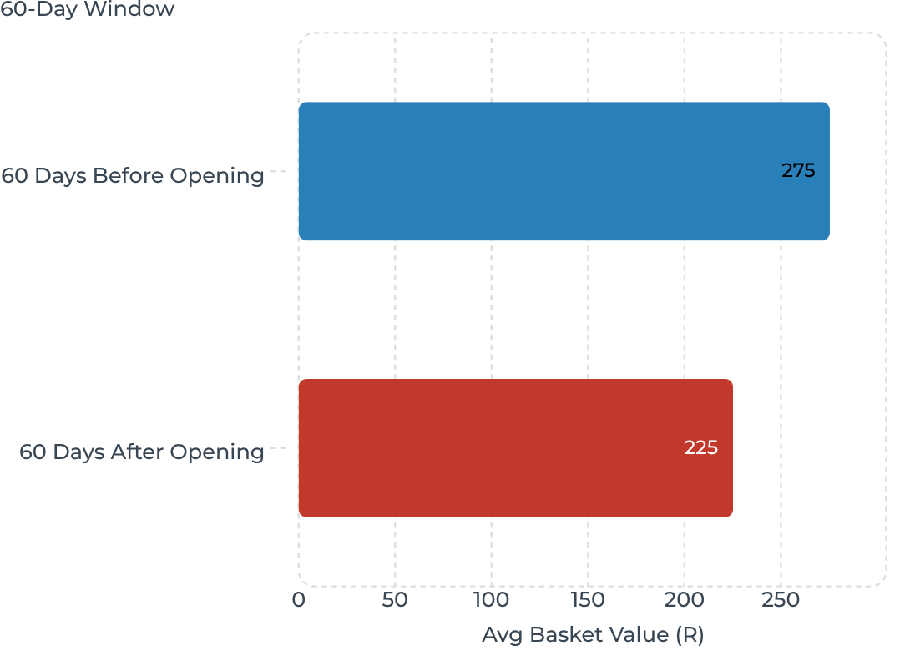

HYPOTHESIS 1 · COMPETITION
Competitive Exposure Aligns With a Materially Steeper Basket Decline
Before vs After Competitor Opening
So what: Exposed stores declined -15.8% vs -7.2% for non-exposed — more than double the rate.
So what: A -18.2% basket drop around recorded competitor openings is the strongest single signal in this dataset.
Association, not causal proof. Competitor-exposed stores may differ in location, demographics or format. Controlled analysis with matched stores is needed to confirm causation.

Slide 8
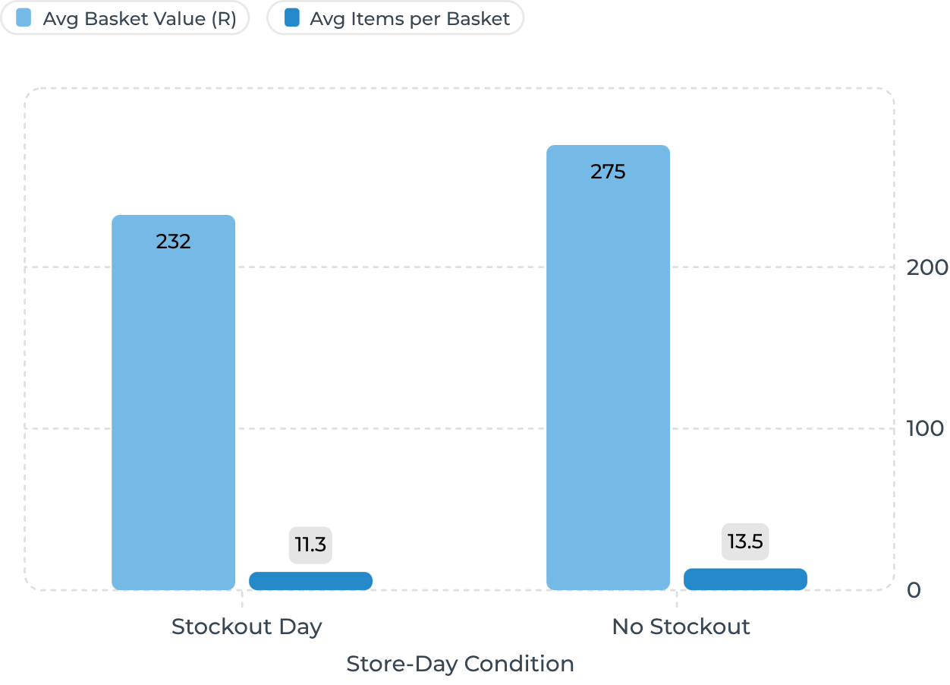
HYPOTHESIS 2 · AVAILABILITY
Stockout Days Are Associated With 15.7% Lower Basket Value and 16.1% Fewer Items
Stockout Context
Scale of the Problem
119 stockout events recorded across 42 stores, generating 606 affected store-days in the sample period.
Basket Gap
R43.25 average basket gap between stockout and non-stockout days — a significant per-trip value loss that compounds across high-frequency categories.
So what: 119 stockout events affecting 606 store-days show materially smaller baskets — empty shelves likely cut short the shopping trip.
Caveat
Association only. Stockout days may coincide with other factors (e.g. competitor promotions, weekend traffic). Root-cause review per store-day is required.

Slide 9
ROOT CAUSE & ACTIONS
Two High-Priority Hypotheses, Four Targeted Interventions
Hypothesis Scorecard
Prioritised Actions
Hypothesis | Status | Evidence
Competition | Priority | Exposed stores -15.8%; before/after -18.2%
Availability / Stockouts | Priority | Stockout days -15.7% basket value
Customer Behaviour | Contributor | Non-loyalty -12.3%; loyalty -7.0%
Pricing | Untestable | No item-level price data in dataset
Payment / Day-of-Week | Secondary | No material effect identified
01
Competitive Store Response
Targeted value bundles and key-value-item price checks in exposed stores. Owner: Pricing + Merchandising.
02
Stockout Control
High-impact category alerts, replenishment thresholds and store-day root-cause reviews. Owner: Operations + Supply Chain.
03
Basket-Building Programme
Cross-category bundles, add-on prompts and loyalty conversion offers targeting non-loyalty shoppers. Owner: CRM + Merchandising.
04
Gauteng Pilot First
Test all interventions in highest-impact Gauteng stores with matched controls before national rollout.

Slide 10
CLOSING
Protect the Basket, Not Just the Footfall.
🔴 The Decline Is Real
🎯 Two Actionable Hypotheses
📊 Test Before You Scale
Average basket value fell from R299.82 to R248.56 across all provinces, formats and customer segments — an unbroken 12-month structural trend.
Competitive exposure (-15.8% decline) and stockout days (-15.7% basket gap) are the strongest, most actionable signals in the current data.
Pilot targeted interventions in Gauteng with matched controls. Measure weekly: avg basket value, items/basket, volume, stockout hours and competitor gap.
Analytical Limitations
Sample transactions: revenue totals are not FreshMart's exact chain turnover
Association ≠ causation: all hypotheses require controlled testing to confirm
Pricing untestable: item-level price and margin data are needed to evaluate pricing as a root cause
Measurement plan: weekly dashboard tracking basket KPIs, treatment vs control stores

